Slide 1
Angular - Services
Peter Eijgermans peter.eijgermans@ordina.nl

Slide 2
Services
Target – make data functionality reusable for different components:
Data retrieval, Data caching, Data Storage

Slide 3
Singleton?
Services are singletons
They are a singleton for the Module and all child components.
Module/Site-wide usage?
Instantiate the service in app.module.ts
4

Slide 4
Data flow
View
{{…}}
Class / Component
Service
Save your data via Http
API → Database

Slide 5
Data flow
View
{{…}}
Class / Component
Service
View
{{…}}
Class / Component

Slide 6
Why use a Service?
Make data functionality reusable for different components
Data functionality available for all components
Data will be available when you switch from component/view
(components are volatile to “share” data)
Contains logic that is not directly related to the view!!!

Slide 7
Basic Rule Service
Put all your (business)logic in the service !
The Component should be lean and mean !

Slide 8
Services in Angular
Data services in Angular:
import {Injectable} from '@angular/core';
@Injectable({ providedIn: 'root' })
export class CityService{
//....
}
Notes:
The @Injectable() decorator marks it as a service that can be injected

Slide 9
Steps to make a Service
Step 1 – create a service
Step 2 – consume/inject service in component
Step 3 – inject service in Module (app.module.ts)

Slide 10
Step 1 – service (static data)
import { Injectable } from '@angular/core'; import { City } from './city.model'; @Injectable({ providedIn: 'root' }) export class CityService { public cities: City[] = [ new City(1, 'Groningen', 'Groningen'), ]; // retourneer alle cities public getCities(): City[] { return this.cities; } // retourneer city op basis van ID public getCity(id: number): City { return this.cities.find(c => c.id === id); } }

Slide 11
Step 2 – Service consume/inject
import { CityService } from './city.service'; @Component({ selector: 'hello‐world', templateUrl: 'app/app.html', }) export class AppComponent implements OnInit { // Properties voor de component/class public currentCity: City; public cities: City[]; public cityPhoto: string; constructor(private cityService: CityService) {} public ngOnInit(): void { this.cities = this.cityService.getCities(); } public getCity(city: City): City { this.currentCity = this.cityService.getCity(city.id); this.cityPhoto = `img/${this.currentCity.name}.jpg`; console.log('City opgehaald:', this.currentCity); } }
Constructor: shorthand voor nieuwe private variable + instantiering!
local variables
Detailgegevens voor city bij (click) event

Slide 12



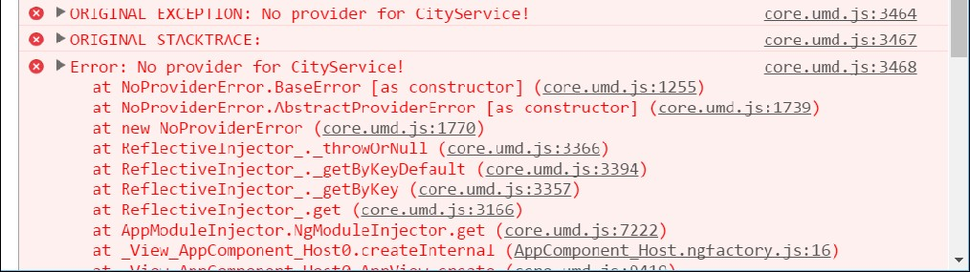
“No provider for CityService”
Solution: inject in app.module.ts

Slide 13
Step 3 – Inject service in Module (app.module.ts)
Use the annotation providers:[ … ]
// Module declaration
@NgModule({
imports : [BrowserModule], declarations: [AppComponent],
bootstrap providers
: [AppComponent],
: [CityService, GoogleService] // DI voor service
})
export class AppModule {
}
Array met Service- dependencies

Slide 14
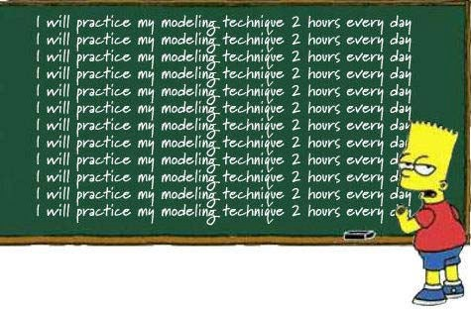
Checkpoint
See 5a
Exercise….

Slide 15
Async services

Slide 17
Async services
App, met
View
Webserver, met API &
Database
Internet
Controller
Ajax-call, met Http
Service

Slide 18
Async Services
Work with HttpClient: asynchrone actie
AngularJs: Promises
Angular : Observables
Use in Angular : ReactiveX library RxJS

Slide 19

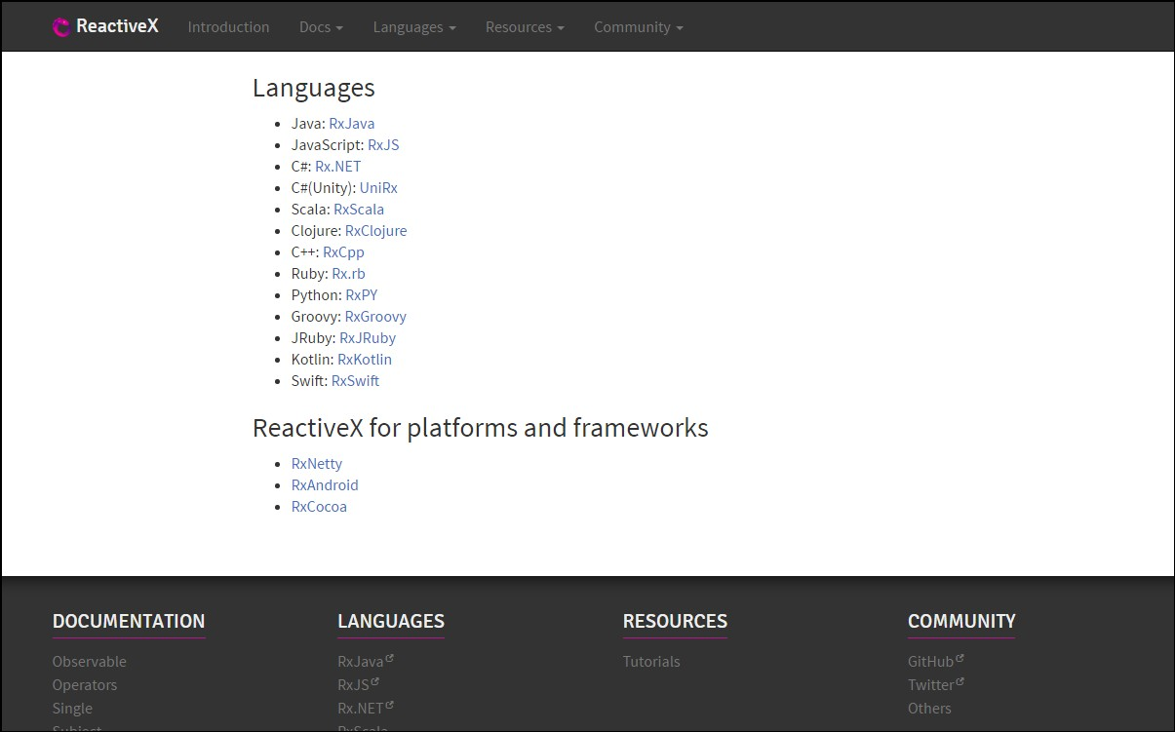
http://reactivex.io/

Slide 20
Observable
Subscribe
Notes:
You are a Observer = Listener and Subscriber on the data
TV is the Observable = Provider of Async data

Slide 21
Observable
Returns a stream of values over time

Slide 22


Slide 23
Observable
Cancelable
Returns a stream of values over time
Lazy
Subscribe to the stream (push mechanism)
Array-methods on stream → map(), filter(), reduce()
Notes:
Lazy: er gebeurt niks met de ontvangen stream, totdat hij aangeroepen wordt
Observable is te vergelijken met een array, die langzamerhand gevuld wordt met data.
Omdat een observable zich gedraagd als een array, zijn allerlei array methods beschikbaar, zoals: map(), filter(), reduce()
Example stream: list of ’share prices’ which changes each minute.

Slide 24
Interactive diagrams of Rx Observables
http://rxmarbles.com/
RXFiddle.net

Slide 25
Async services
App, met
View
Webserver, met API &
Database
Internet
Controller
Ajax-call, met Http
Service

Slide 26
Example Http / cities.json
Make a data-file: cities.json
"cities": [
{
"id": 1,
"name": "Groningen",
"province": "Groningen",
"rating": 0,
"highlights": "Martinitoren"
},
…
]

Slide 27
Step 1 - Inject HttpClient in Service
import { Observable } from 'rxjs'; import { HttpClient } from '@angular/common/http'; @Injectable() export class CityService { constructor(private http: HttpClient) {} // retourneer alle cities public getCities(): Observable<City[]> { return this.http.get<City[] >('app/cities.json'); } }
Maak lokale variabele http
Retourneer observable naar de Component

Slide 28
Step 2 – Change component
export class AppComponent implements OnInit { // Properties voor component/class public currentCity: City; public cities: City[]; public cityPhoto: string; constructor(private cityService: CityService) {} public ngOnInit() { this.cityService.getCities() .subscribe(cityData => { this.cities = cityData; }, err => console.log('FOUT: ', err), () => console.log('Getting cities complete')); } }
Data async ophalen en .subscribe() gebruiken

Slide 29
Step 3 – Change module
// Angular Modules
…
import {HttpClientModule} from "@angular/common/http";
…
// Module declaration
@NgModule({
HttpModule importeren en toevoegen
imports
: [BrowserModule, HttpClientModule],
declarations: [AppComponent],
bootstrap providers
: [AppComponent],
: [CityService] // DI voor service
})
export class AppModule {
}

Slide 30
More about Observables
Part of RxJs
subscribe() has 3 parameters:
success
▪
error
complete
this.cityService.getCities()
.subscribe(cityData => {
this.cities = cityData;
},
err => console.log(err),
()=> console.log('Getting cities complete...')
)

Slide 31
Checkpoint Async services
Oefening 5b)
Exercise….

Slide 32
How to import RxJs in your application?
import 'rxjs’;
import {Observable} from ‘rxjs’;
import {map, filter, delay, retry} from 'rxjs/operators';
Notes:
Piping. Resultaat van de een functie (retry, delay) dient als invoer voor de volgende functie.

Slide 33
PIPING
r
import rxjs operatoren
import { retry, delay } from 'rxjs/operators’; export class AppComponent implements OnInit { // Properties voor de component/class public currentCity: City; public cities: City[]; public cityPhoto: string; constructor(private cityService: CityService) {} public ngOnInit(): void { this.cityService.getCities() .pipe(retry(10), delay(2000)) .subscribe(cityData => { this.cities = cityData; }, err => console.log('FOUT: ', err), () => console.log('Getting cities complete')); } }
Data async ophalen en retry and delay als ophalen mislukt
Notes:
Piping. Resultaat van de een functie (retry, delay) dient als invoer voor de volgende functie.

Slide 34
RxJS-operators in the service
import { City } from '../model/city.model'; import { HttpClient } from '@angular/common/http'; import { catchError, tap } from 'rxjs/operators'; import { Observable, throwError } from 'rxjs'; @Injectable() export class CityService { constructor(private http: HttpClient) {} // retourneer alle cities public getCities(): Observable<City[]> { return this.http.get<City[]>('app/cities.json') .pipe( tap(cities => { console.log('this is my city', cities[0]); localStorage.setItem('KEY', cities[0]); }), catchError(err => throwError(err)) ); } }
import rxjs operatoren
Tap: Transform stream in de service
Tap for side-effects
Notes:
Tap is used for side effects: logging, localstorage. Manupilating the DOM

Slide 35
Checkpoint piping
See 5c
Exercise….

Slide 36
CRUD applicatie
POST
PUT
DELETE
GET
Notes:
https://blog.angularindepth.com/angular-question-rxjs-subscribe-vs-async-pipe-in-component-templates-c956c8c0c794

Slide 37
Adding a City
const headers = new HttpHeaders().set('Content-Type', 'application/json');
const HEADERS = {headers: headers};
addCity(cityName: string): Observable<City> {
const newCity = new City(null, cityName);
return this.http.post<City>( → <City> is return type
API_URL,
JSON.stringify(newCity),
HEADERS
)
}

Slide 38
Update a City
updateCity(city: City): Observable<City> {
return this.http.put<City>(
`${url}/${city.id}`,
JSON.stringify(city),
headers)
}

Slide 39
Delete a City
deleteCity(city) {
return this.http.delete(`${url}/${city.id}`)
}

Slide 40

CRUD application
Notes:
https://blog.angularindepth.com/angular-question-rxjs-subscribe-vs-async-pipe-in-component-templates-c956c8c0c794

Slide 41
Checkpoint CRUD applicatie
See 5d
Exercise….

Slide 42
Async pipe
.subscribe() versus | async
| Async also unsubscribes !!!
Notes:
https://blog.angularindepth.com/angular-question-rxjs-subscribe-vs-async-pipe-in-component-templates-c956c8c0c794

Slide 43
DEMO 206 services–async-pipe
<li *ngFor="let city of cities$ | async”>
{{ city.id}} - {{ city.name }}
</li>

Slide 44
Advantages Async pipe
No subscribe() needed
No unsubscribe() needed
Change detection is triggered when observable changes !
Saves boilerplate code in component

Slide 45
Checkpoint async pipe
Start applicatie services–async-pipe
Oefening….

Slide 46
Live API’s
36

Slide 47
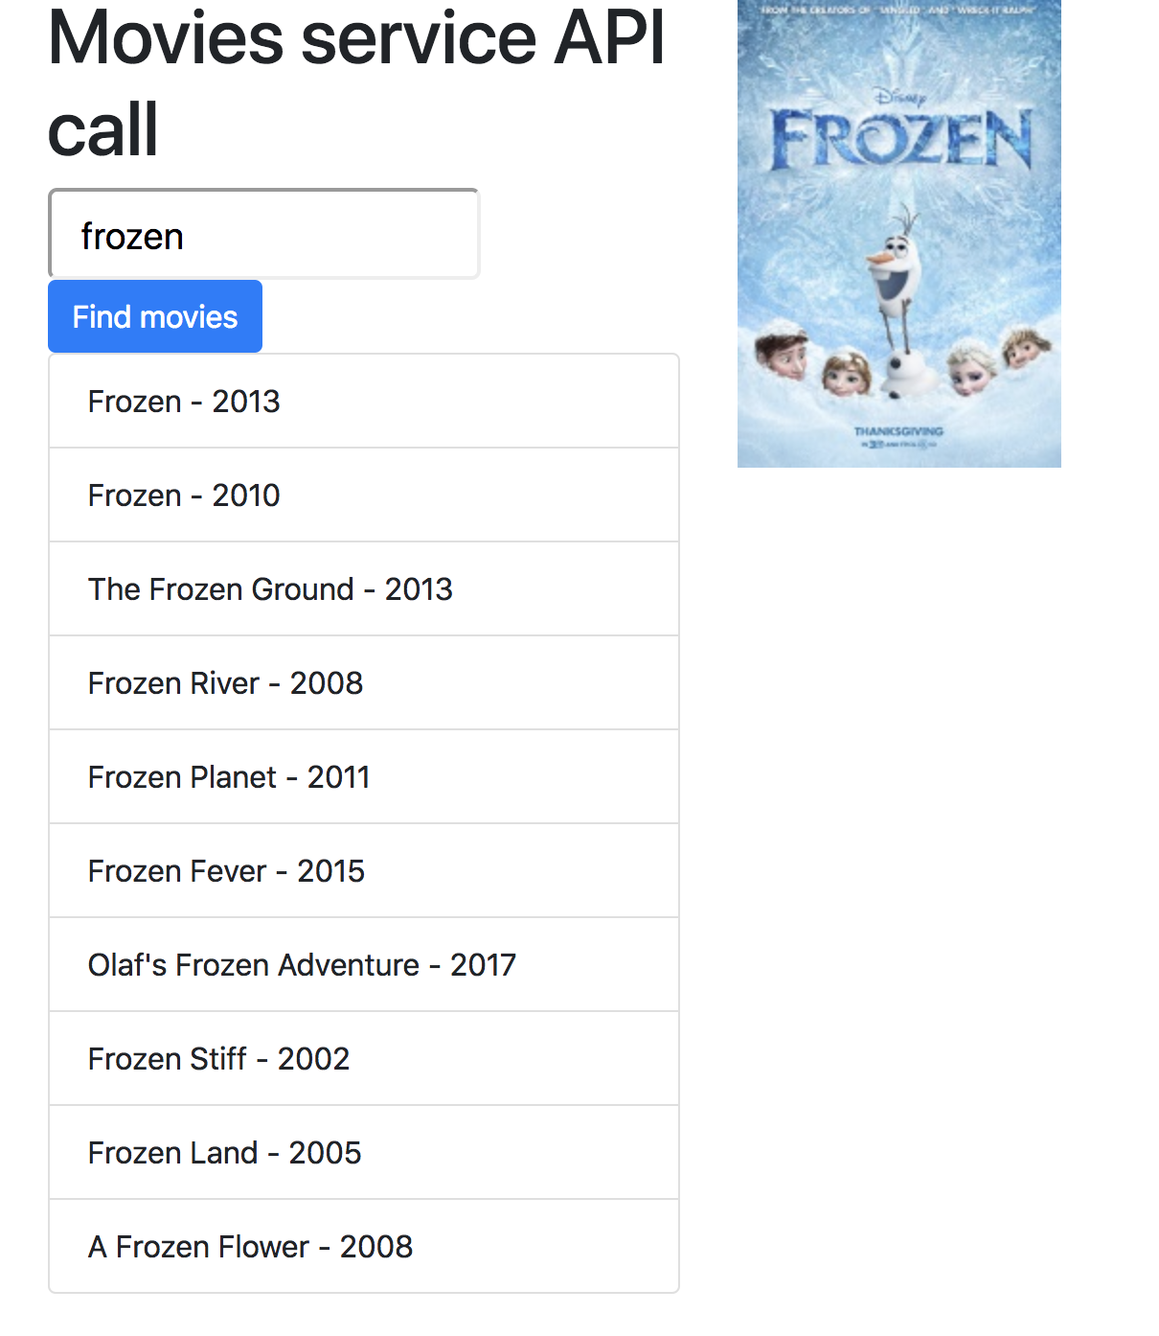
Movies services API call
210-Service Live
211-Service Live with mapping

Slide 48
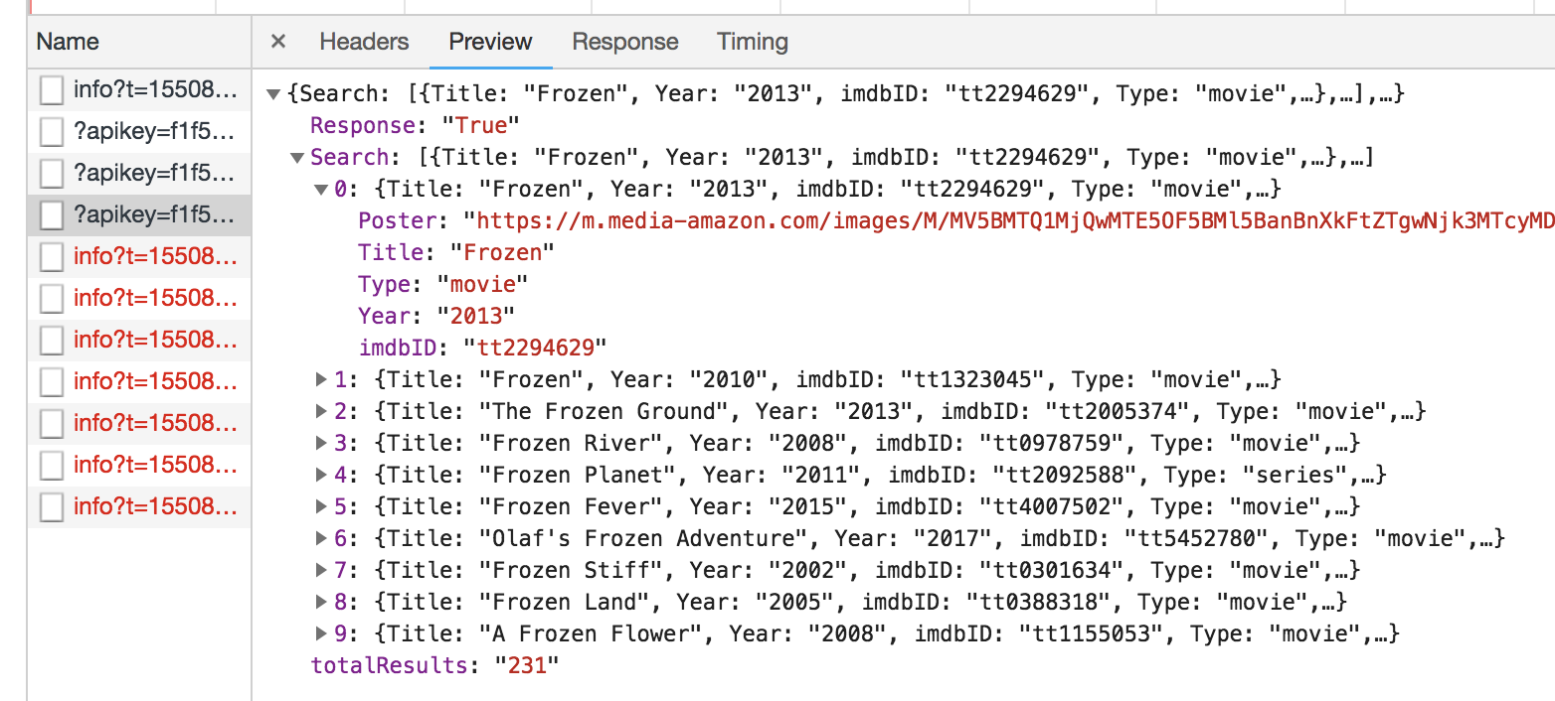

Slide 49
MovieModel
export class MovieModel{
constructor(public titel:string,
public jaar:string,
public afbeelding:string) {
}
}

Slide 50
Weather API

Slide 51
Weather API
Step 1: Get Weather Json
http://api.openweathermap.org/data/2.5/weather?units=metric&appid=8566d604cd9402b65394b034e52aa2af&q=Gouda
Step 2: Generate TypeScript interfaces from JSON
http://json2ts.com/
Step 3 Use the TypeScript interface in the C08-Application

Slide 52
Weather API app
See project: C08-services-live-weather

Slide 53
Voorbeeld API’s
http://openweathermap.org/API (weerbericht)
http://filltext.com/ (random NAW-gegevens)
http://ergast.com/mrd/ - Ergast Motor (F1) API
http://www.omdbapi.com/ - Open Movie Database
http://swapi.co/ - Star Wars API
Zie ook JavaScript APIs.txt met meer voorbeelden

Slide 54
Checkpoint
See 5e
Exercise….
38

Slide 55
Injectors

Slide 56
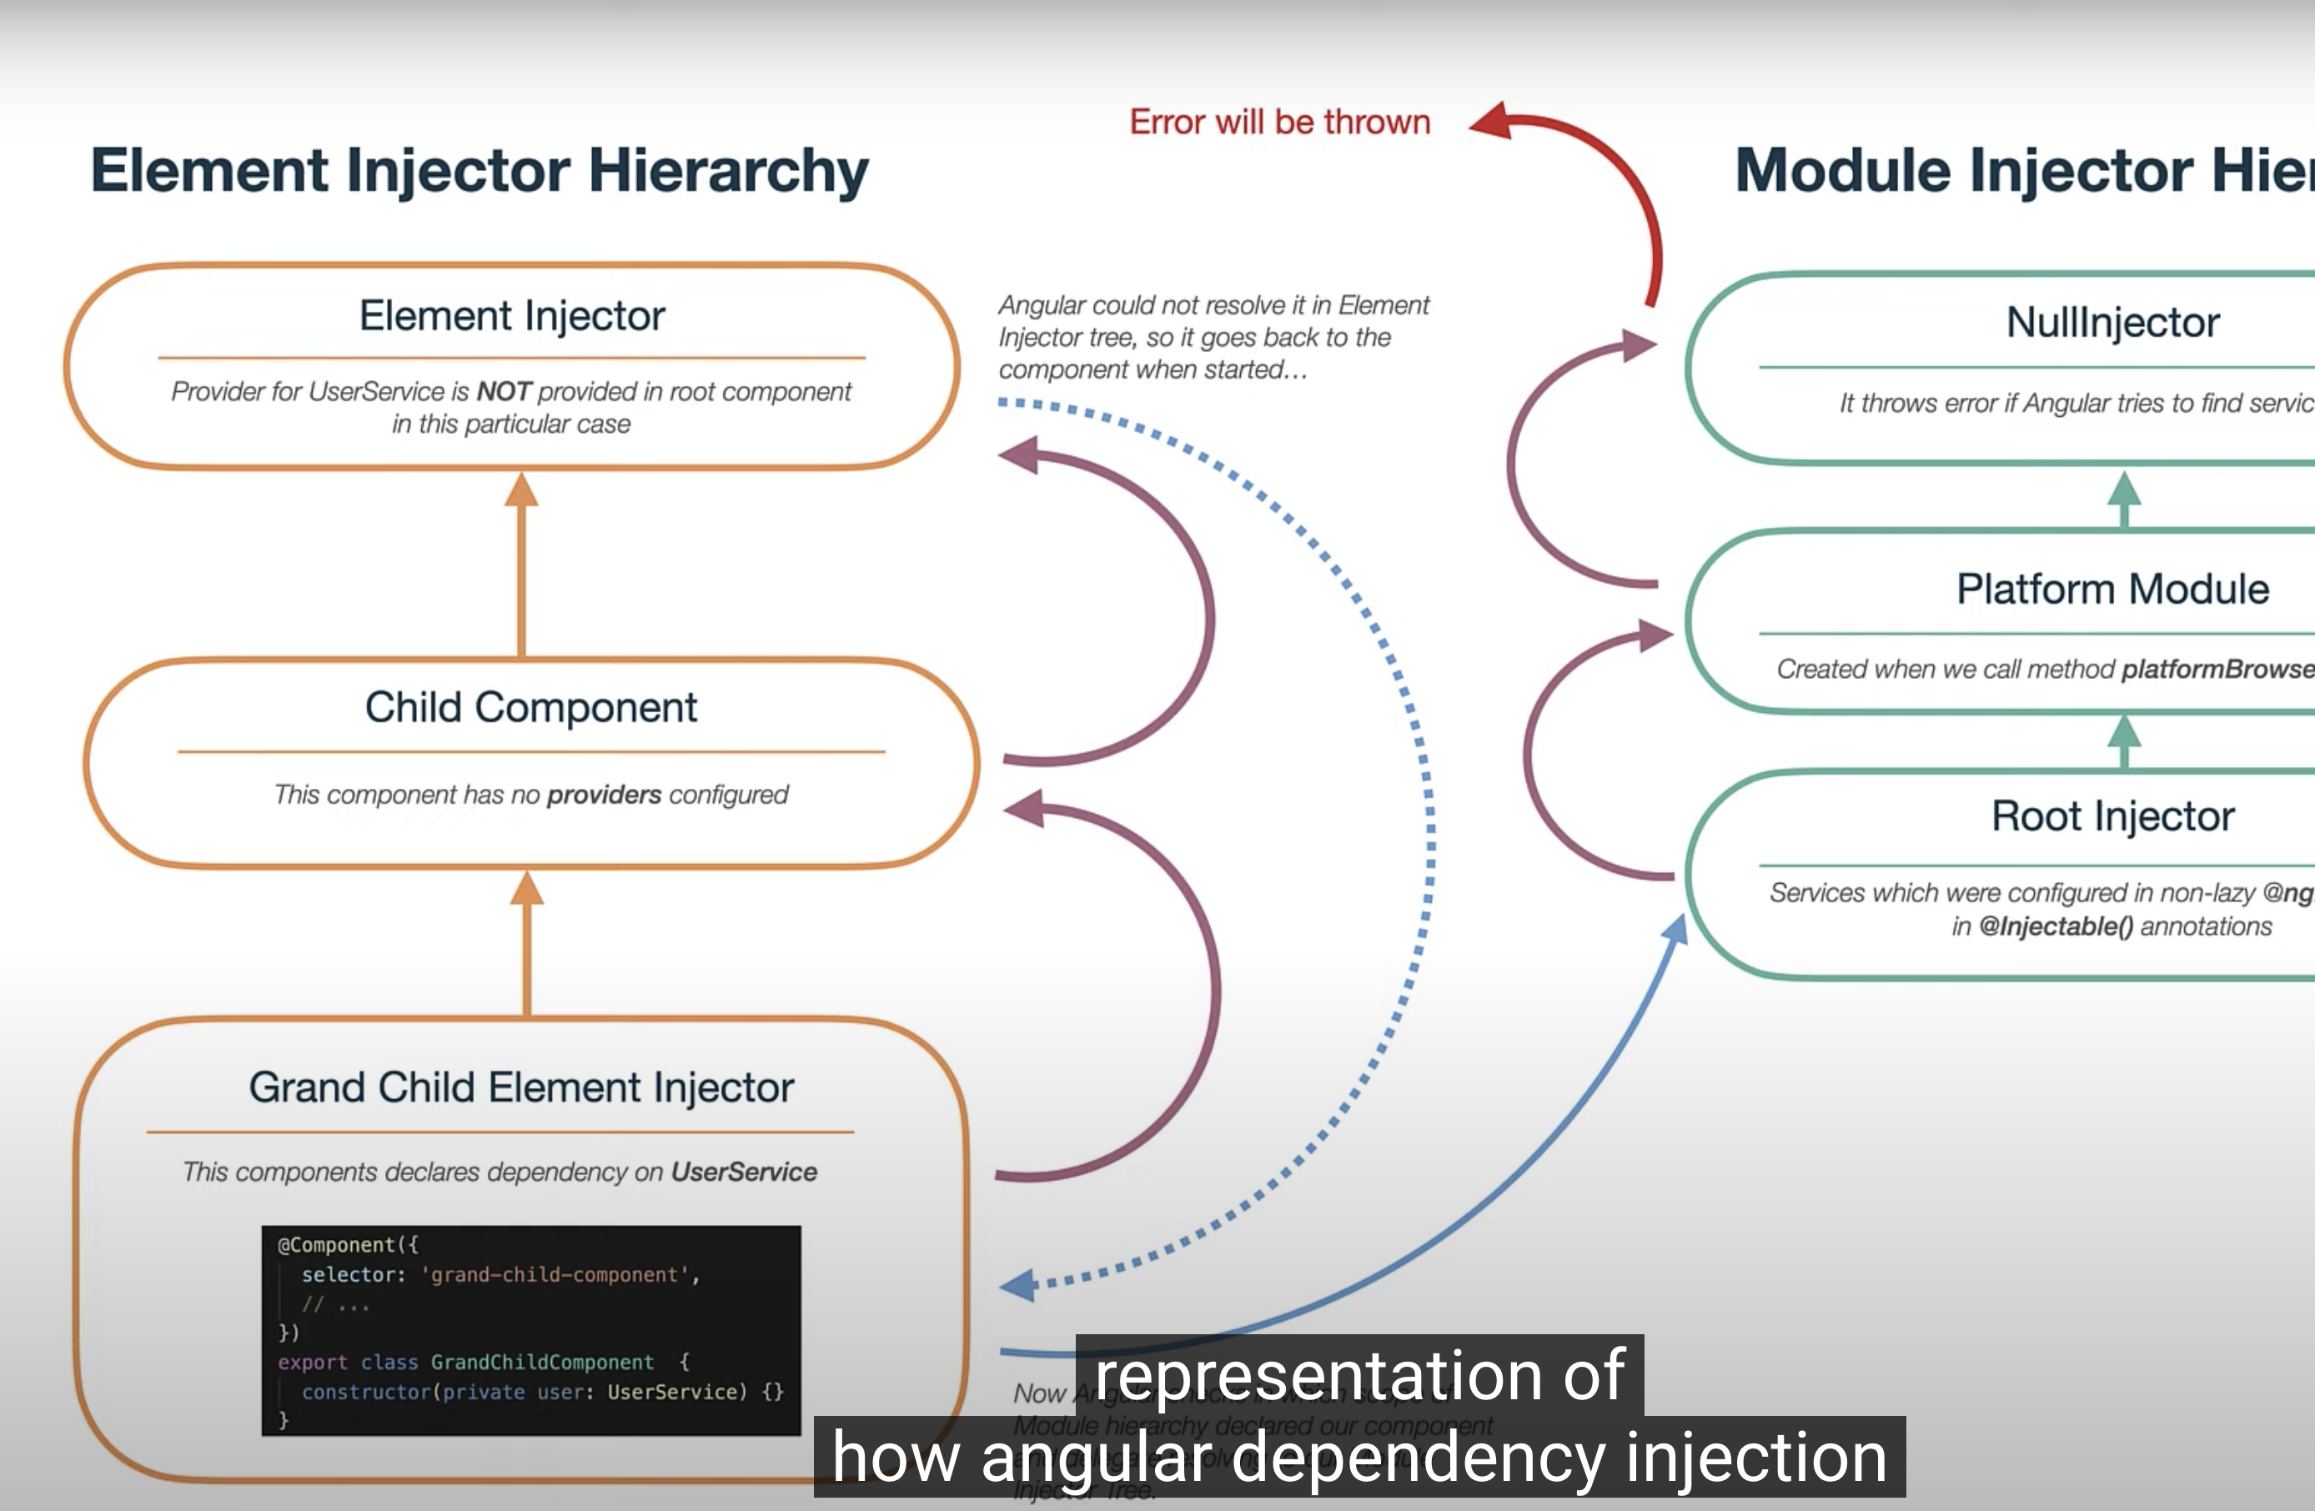

Slide 57
Injectors
DEMO: https://www.youtube.com/watch?v=G8zXugcYd7o
Dependency Injection in Angular DI is a coding pattern in which a class asks for dependencies from external sources rather than creating them itself. The injector: is responsible for creating service instances AND injecting them into classes. A provider: tells an injector how to create the service. A provider can be the service class itself, so that the injector can use new to create an instance

